Slide 1
Every Activism is Political Activism in Argentina: Discursive Strategies for Animal Rights in Beef land
Diego L. Forte
Universidad de Buenos Aires
Facultad de Filosofía y Letras

Slide 2
1.Living in Beef land: Asado as a political matter

Slide 3
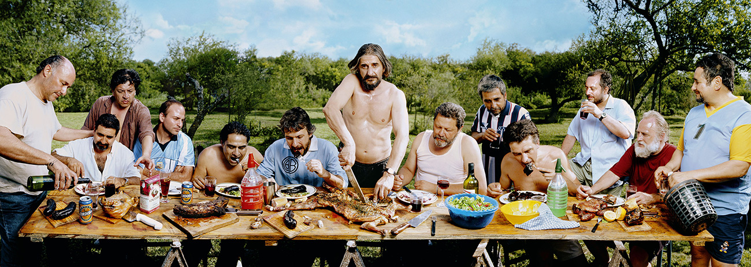
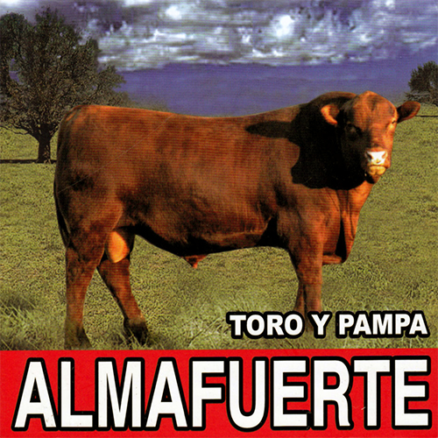
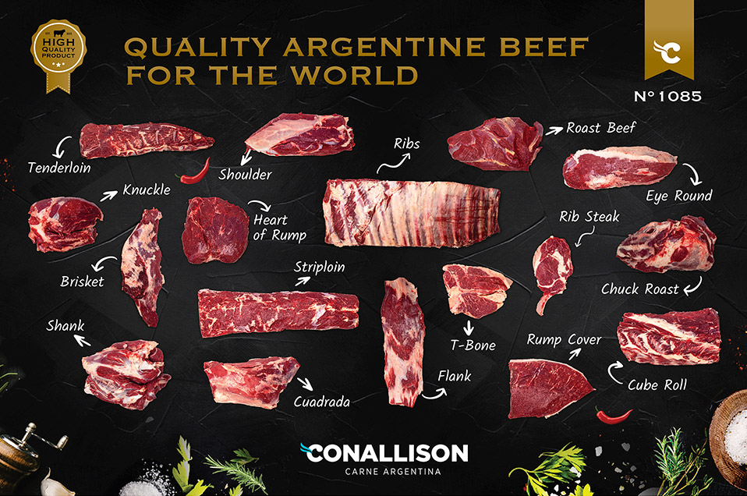
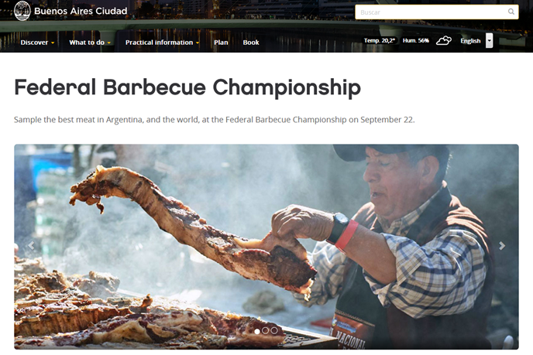
ASADO EN MENDIOLAZA, CÓRDOBA; 2001
MARCOS LÓPEZ

Slide 4
CORPUS
Animal Libre Argentina
Animal Save Argentina
El Vegano Cordobés

Slide 5
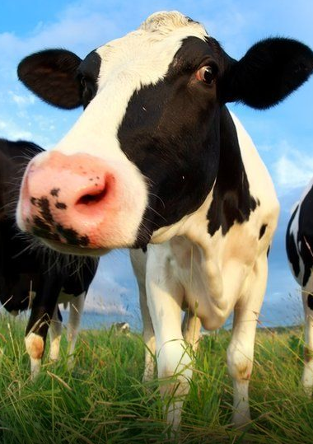
FRAMEWORK
Kress & van Leeuwen (2005)
Ekman & Friesen (1978, 1986, 2003)
Forte (2020)

Slide 6
METHODOLOGY
Interpersonal metafunction
Image act and gaze: offer and demand
Size of frame and social distance: long/close shot
Perspective and the subjective image: up/down
Modality markers: emotional traces

Slide 7
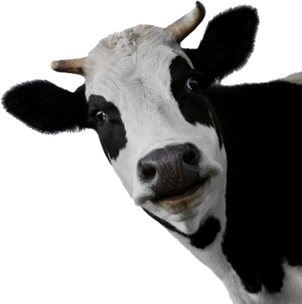
CARRY FREEMAN (2014)
Pragmatic strategies
Radical strategies

Slide 8
2.
ANIMAL LIBRE ARGENTINA

Slide 9
ANIMAL LIBRE ARGENTINA

Slide 10
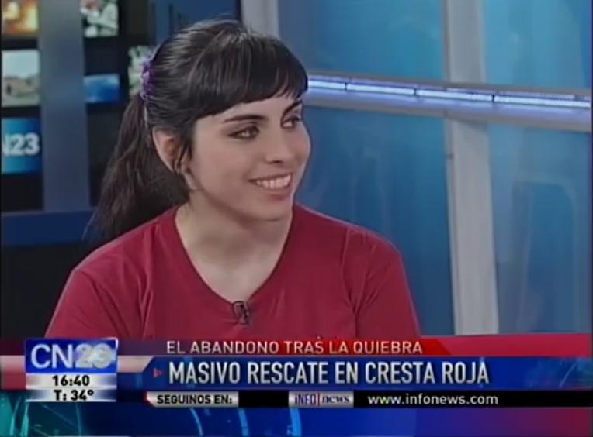
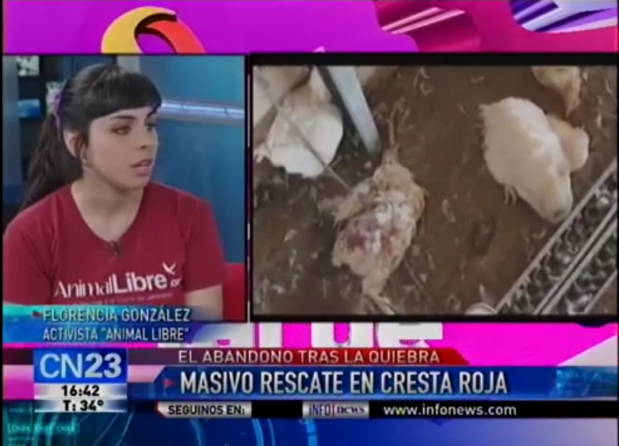
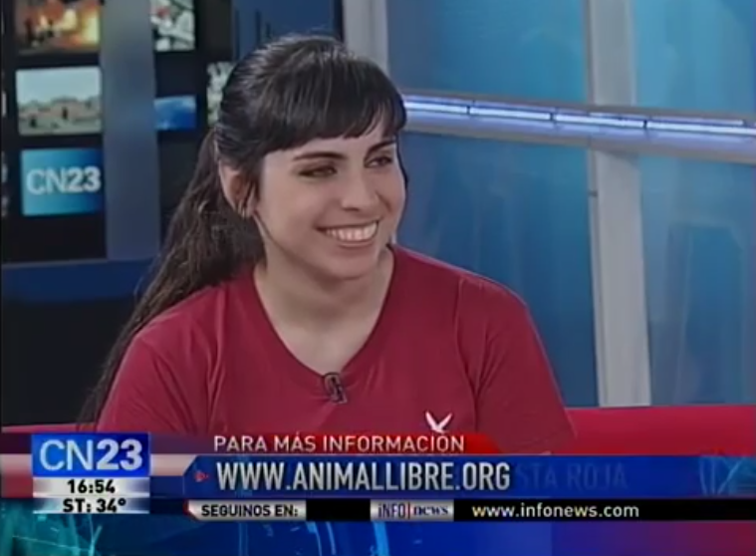

Slide 11
ANIMAL LIBRE ARGENTINA
Pragmatic strategies
Act of offer
Medium close shot
No effects
Seriousness and positive emotions

Slide 12
3.
ANIMAL SAVE ARGENTINA

Slide 13
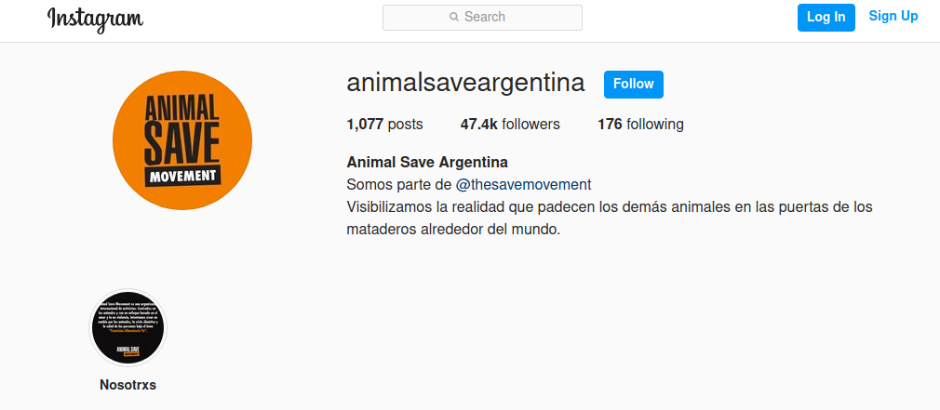
ANIMAL SAVE ARGENTINA

Slide 14
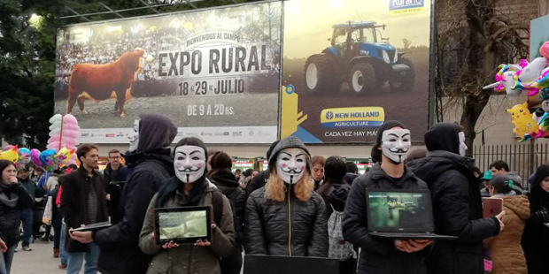
ANIMAL SAVE ARGENTINA

Slide 15
ANIMAL SAVE ARGENTINA
Radical strategies
Indirect act of demand
Full frame
Live interaction
Negative emotions (when no masks)

Slide 16
4.
EL VEGANO CORDOBÉS

Slide 17
EL VEGANO CORDOBÉS

Slide 18
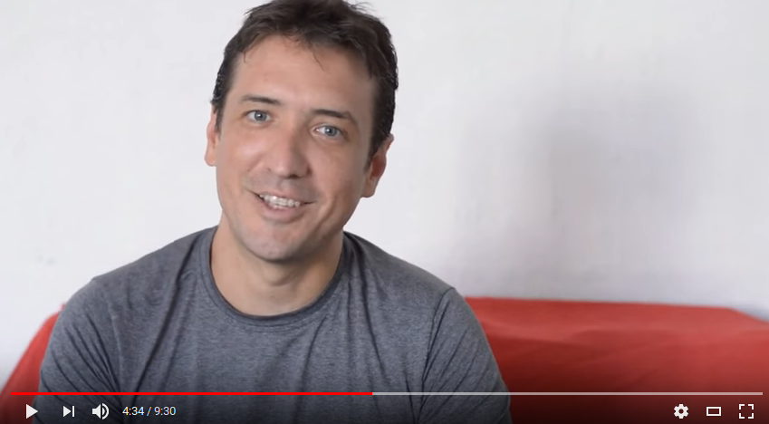
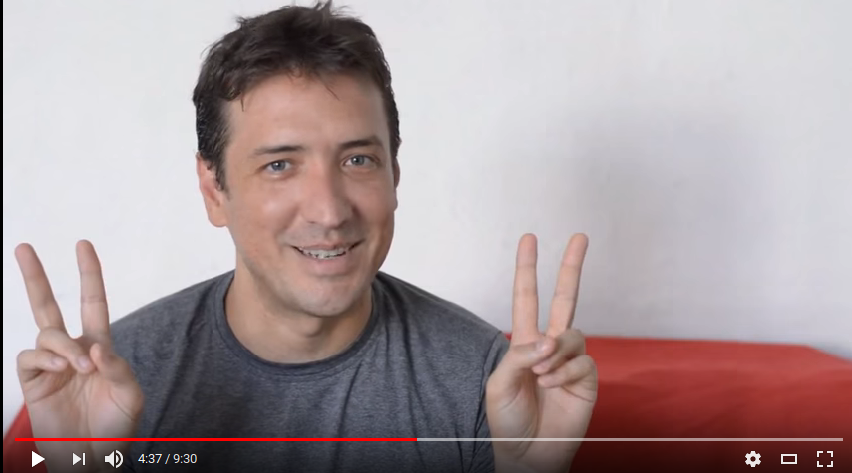
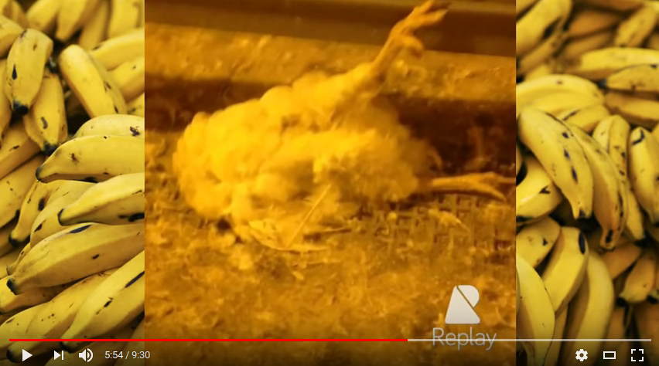

Slide 19
EL VEGANO CORDOBÉS
Pragmatic and radical strategies
Act of offer and demand
Medium and close shot
Black and white effects
Positive and negative emotions. Irony

Slide 20
Summary
Pragmatic strategies
Long media appearances
Offer before demand
Positive emotions
Close shots
Perspective: equal level
Radical strategies
Street action
Demand before offer
Negative emotions
Close shots
Perspective: equal level

Slide 21
REFERENCIAS
Adams, C. (2017)[1990]. The Sexual Politics of Meat. A feminist-vegetarian critical theory. New York: Bloomsbury.
Ekman, P. & Friesen, W. (1978). Unmasking the face. New York: Prentice Hall.
Ekman, P. & Friesen, W. (1986). A new pan-cultural facial expression of emotion. Motiv Emot 10, 159–168.
Freeman, C. (2014). Framing farming: Communication strategies for animal rights. New York, Rodopi.
Hart, C. (2014). Discourse, Grammar and Ideology: Functional and Cognitive Perspectives. London: Bloomsbury.
Joy, M. (2010). Why we love dogs, eat pigs and wear cows. An introduction to Carnism. San Francisco: Conari Press.
Kress, G. & van Leeuwen, T. (2005). Reading images: a grammar of visual design. London:, Routledge.
Forte, D. (2020). Discurso dominante y borramiento: el caso de los animales no humanos en el conflicto Cresta Roja. LL Journal, Vol. 15 No. 1. Spring. New York.

