Slide 1
Narratives of the Vegan Hero
Mario Leto
Meiji University
University of Gloucestershire
a positive ecolinguistics analysis

Slide 2
Theoretical framework: Ecolinguistics (Stibbe 2021)
Linguistic theories:
Narrative theory (Todorov 1977; Herman 2003)
Prototypical narrative structure of the hero’s journey (Campbell 1949; Leeming 1998, 2002)
Convictions and facticity patterns (Potter 1996)
Constructed opposition (Davies 2013; Jeffries 2014)
Morgan Mitchell
400m world champion

Slide 3
Framing Narrative Structure
EQUILIBRIUM
James Wilks as meat eater, UFC fighter, combat trainer
SEPARATION
James gets injured
CONFLICT
James needs to heal efficiently
INITIATION
James discovers vegan benefits
NEW EQUILIBRIUM
James as vegan, healed
RETURN
James shares his vegan wisdom
Narrator James Wilks
UFC fighter, combat trainer
Todorov (1977)
Campbell (1949)

Slide 4
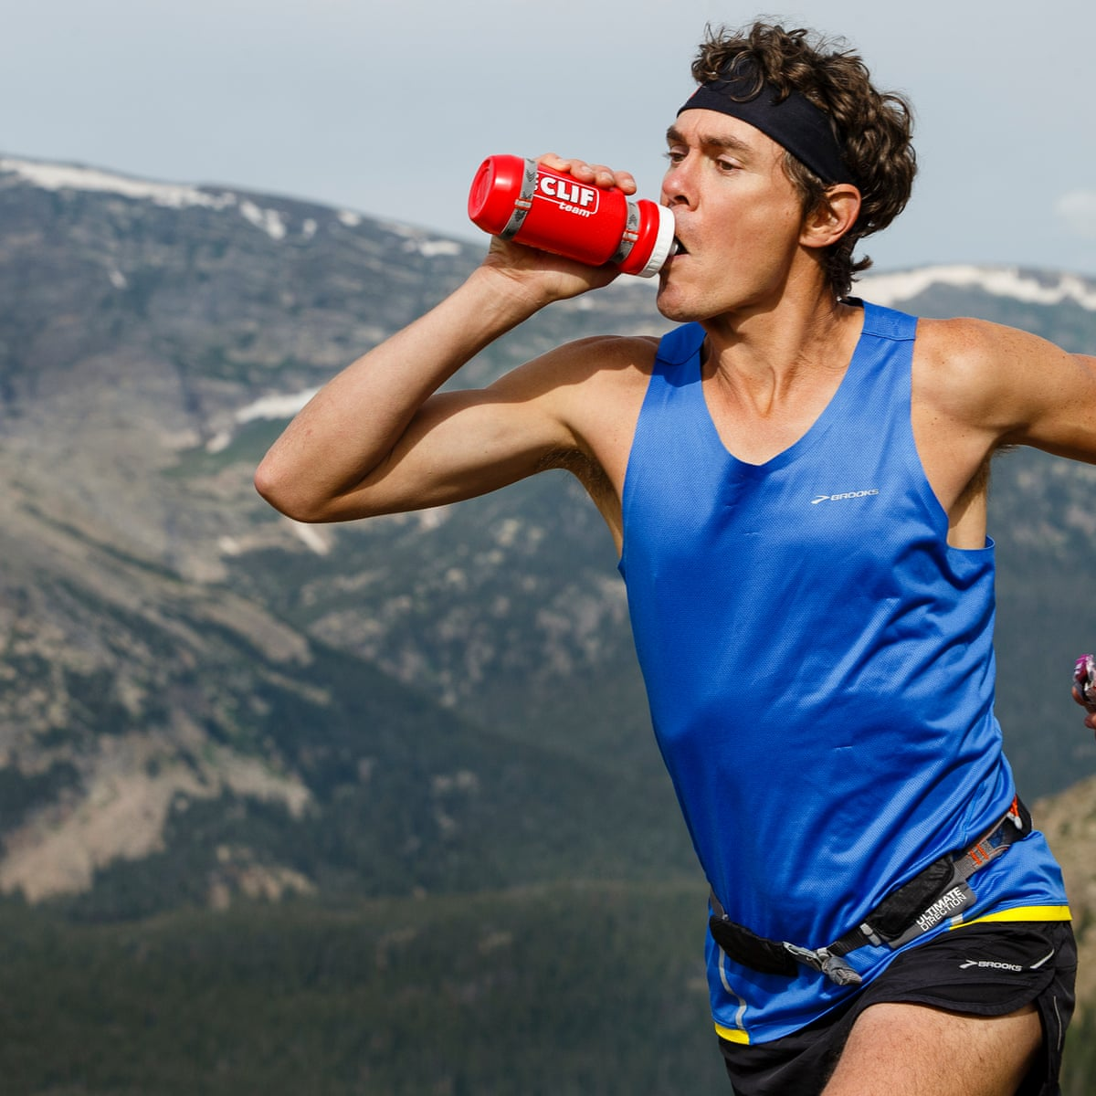
The narrative the game changers is driven by
22 misconceptions about veganism (Narrator James Wilks)
21 expert sources (corrective knowledge)
19 embedded narratives (exemplifications)
Misconception: Meat gives you energy
Narrator James Wilks: “I was confused about how his meat-free diet could possibly give him enough energy.”
Conviction: ‘plant-based diets can provide enough energy’ is uncertain
Expert Source Dr. James Loomis: “What I found in the locker room was some pretty outdated ideas about nutrition... [The] perception was that [meat] protein was what sustains their energy, but in fact that’s not the case.”
Conviction: ‘plant-based diets can provide enough energy’ is certainly true
Embedded Narrative Scott Jurek: “I led [the Western States race] from start to finish, and won it for seven years in a row, and there was no question that the plant-based diet was fueling my victories.”
Scott Jurek
record-holding ultramarathoner

Slide 5
All narratives in the documentary are identified by their temporal sequence and logical connections centered upon the moment of transition to a vegan diet.
“In the narratological literature, narrative is broadly defined as a sequentially organized representation of a sequence of events... In this context, events can be understood as time- and place-specific transitions...” (Herman 2003: 2)
Embedded Narrative Patrik Baboumian:
“I stopped eating meat in 2005. Up to that time I was 105 kilo, and now I’m 130 kilos. Also, at the same time I set like four world records, so when I stopped eating meat, I got stronger and bigger.”
Embedded Narrative Morgan Mitchell:
“A lot of people had doubted me when I first became vegan, but my energy levels increased incredibly and my iron, my B12, everything that people said would become deficient, were amazing.”
Patrik Baboumian
world-record-holding strongman

Slide 6
Most importantly, the narrative the game changers communicates both explicit and implied narrative entailments.
Narrative entailments are “the underlying messages or morals within narratives which can be extracted, taken outside the narrative itself, and applied to everyday life” (Stibbe 2021: 184).
Embedded Narrative Dotsie Bausch: “So when I transitioned over to an entirely plant-based diet, I wasn’t sure if I was gonna survive, and I actually became like a machine... My diet was the most powerful aspect to me being able to perform and produce for the US team at the Olympic games.”
Dotsie Bausch
Eight-time US national cycling champion

Slide 7
Most importantly, the narrative the game changers communicates both explicit and implied narrative entailments.
Narrative entailment:
Eating a plant-based diet is beneficial for health
Embedded Narrative Dotsie Bausch: “So when I transitioned over to an entirely plant-based diet, I wasn’t sure if I was gonna survive, and I actually became like a machine... My diet was the most powerful aspect to me being able to perform and produce for the US team at the Olympic games.”
Dotsie Bausch
Eight-time US national cycling champion

Slide 8
Most importantly, the narrative the game changers communicates both explicit and implied narrative entailments.
Narrative entailment:
Eating a plant-based diet is beneficial for health
Embedded Narrative Patrik Baboumian:
“I stopped eating meat in 2005. Up to that time I was 105 kilo, and now I’m 130 kilos. Also, at the same time I set like four world records, so when I stopped eating meat, I got stronger and bigger.”
Embedded Narrative Morgan Mitchell:
“A lot of people had doubted me when I first became vegan, but my energy levels increased incredibly and my iron, my B12, everything that people said would become deficient, were amazing.”
Dotsie Bausch
Eight-time US national cycling champion

Slide 9
Narrative entailments are evaluated against my vegan ecosophy for placement on a beneficial-destructive spectrum.
“an ecosophy becomes a philosophical world view or system inspired by the conditions of life in the ecosphere. It should then be able to serve as an individual’s philosophical grounding...” (Naess 1989: 38)
“Ecosophies are not just statements of philosophical positions but can also include a vision of a better society and the concrete steps necessary to achieve that vision” (Stibbe 2021: 12)
Narrative entailment:
Eating a plant-based diet is beneficial for health
My vegan ecosophy: Vegan Dietary Benefits
Bryant Jennings
Heavyweight boxing title contender

Slide 10
Embedded Narrative Damian Mander:
“the actual biggest threat we have is the meat industry and the land they are continually taking away from what we have left of these natural wilderness areas...”
Expert Source Johan Rockstrom: “Meat plays a disproportionately large role in causing [the] overuse of freshwater.”
Expert Source Rob Baily: “The livestock sector is responsible for fifteen percent of global man-made emissions.”
Narrative entailment:
Animal-based diets are destructive to the environment
My vegan ecosophy: Destructive Environmental Impacts of Animal Farming
Damien Mander
Founder of International Anti-Poaching Foundation

Slide 11
The narrative the game changers is a beneficial story of veganism and needs to be promoted.
Create your own stories using the linguistic triggers and rhetorical structures used in the game changers:
Tell stories that center on the transition to a vegan diet and highlight its beneficial outcomes.
Emphasize the structured opposition through convictions and linguistic markers of contrast like disjunctive conjunctions.
Make your stories epic and follow the journey of the hero, bringing your message of ecological health back to your community.
Lucious Smith, age 60
Former NFL cornerback
Strength and conditioning coach

Slide 12
Framing Narrative Structure
SEPARATION
James gets injured
CONFLICT
James needs to heal efficiently
INITIATION
James discovers vegan benefits
NEW EQUILIBRIUM
James as vegan, healed
RETURN
James shares his vegan wisdom
EQUILIBRIUM
James Wilks as meat eater, UFC fighter, combat trainer
Eat vegan
Get healthy
Be strong
Save the planet
Narrator James Wilks
UFC fighter, combat trainer
Todorov (1977)
Campbell (1949)

Slide 13
“When the hero quest has been accomplished...the adventurer still must return with his [or her] life-transmuting trophy...where the boon may redound to the renewing of the community, the nation, the planet, or the ten thousand worlds.”
(Campbell 2008: 167)
“Our heroes reflect our priorities, our particular cultural values. He or she breaks new ground, can represent all of us. The hero is our second chance. The old ways must be constantly renewed and new understandings developed.”
(Leeming 2002: 117-123)
Greta Thunberg
Environmental activist

