Slide 1
From Naming to Numbers
ICE-5 - 12-14 April 2021 Andrea Boom (University of Leeds – CSC Scholar) Dr Jack Wilson (University of Salford) Prof Janet C.E. Watson (University of Leeds)

Slide 2
Outline
Link between language and nature
Lexical density – colours
Quantification systems
Event descriptions
Current changes and loss of traditional connection with natural world

Slide 3
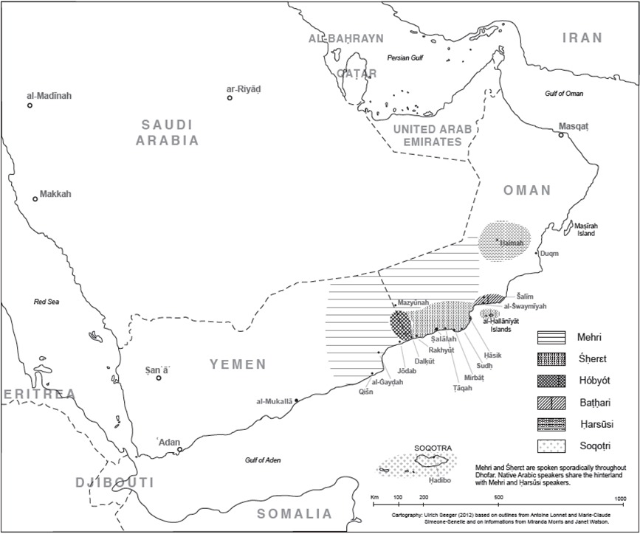
Map from: Marie-Claude Simeone-Senelle
Notes:
The languages our research focuses on are collectively called the Modern South Arabian Languages or MSAL. This map of Yemen, Oman and southern Saudi Arabia shows roughly where the languages are spoken. The data for this talk is all taken from Mehri

Slide 4
Map from: Marie-Claude Simeone-Senelle
Notes:
highlighted now in yellow. Mehri has between 100,000 and 200,000 speakers and is the most widely spoken language of the group. However it has been falling into decline as children grow up speaking mostly Arabic now.

Slide 5
Language and Nature link
Indigenous languages reflect the close relationship between people and their natural environment
Inhabited regions of the world which exhibit greatest biodiversity, exhibit greatest linguistic diversity
Since 1970, 30% loss in biodiversity; recent studies show loss in linguistic diversity tracks or exceeds loss in biodiversity (CELCE 2019; Eniscuola, 2021)
Endangered languages and cultures cluster in the same regions as endangered species (Thomason 2015; Harrison 2007; Gorenflo, Romaine et al. 2012)
Linguistic knowledge used to revive endangered species – e.g. Arabian oryx and Arabian leopard in Oman (Spalton et al. 1999; Christina Anonby, p.c.)
Notes:
We have heard a few talks this week about the connection between languages and their natural environment. These are just a few points about the way that’s see in the literature right now. The main point is that languages and natural environments are closely linked in terms of their health. When biodiversity is in decline we usually also find linguistic diversity in decline. And vice-versa, when languages fall out of use, the natural environment tends to follow suit.

Slide 6
Lexical Density
Notes:
One of the ways languages are closely linked to their environment is through what they describe and what they do not. If speakers of a language are deeply connected with, for example, their livestock, then the language will reflect this with many words relating to the livestock. As the link with the natural environment weakens, the lexical density will also weaken as words fall out of use

Slide 7
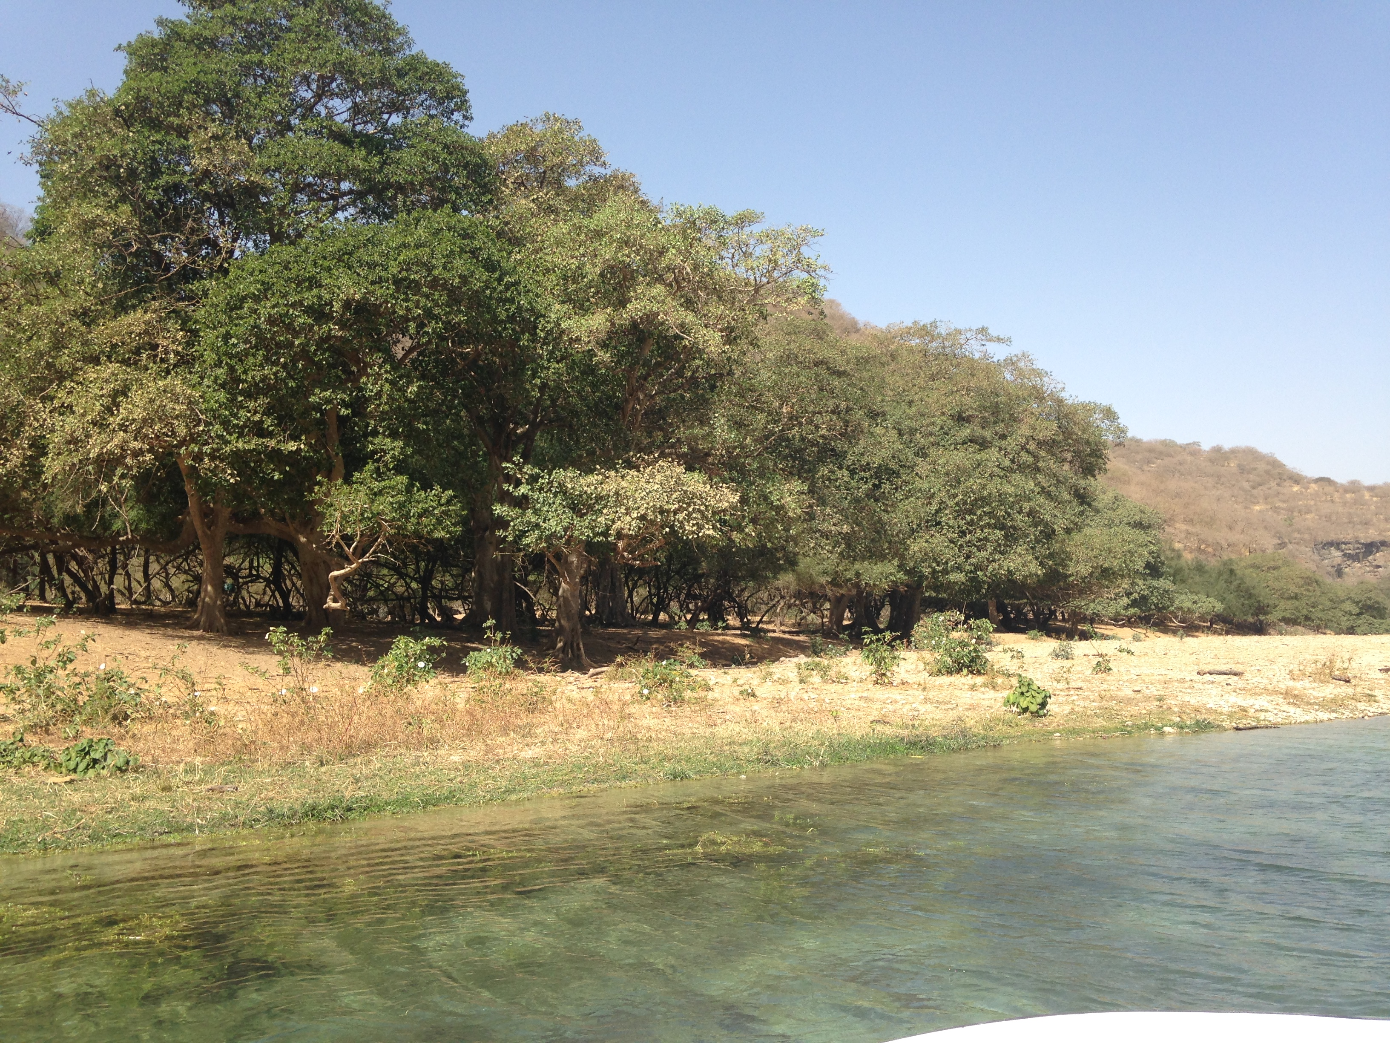
Lexical Density - colours
BASIC
ōfər ‘red’
ḥōwər ‘black’
ūbōn ‘white’
hṣ́awr ‘grullow’

Slide 8
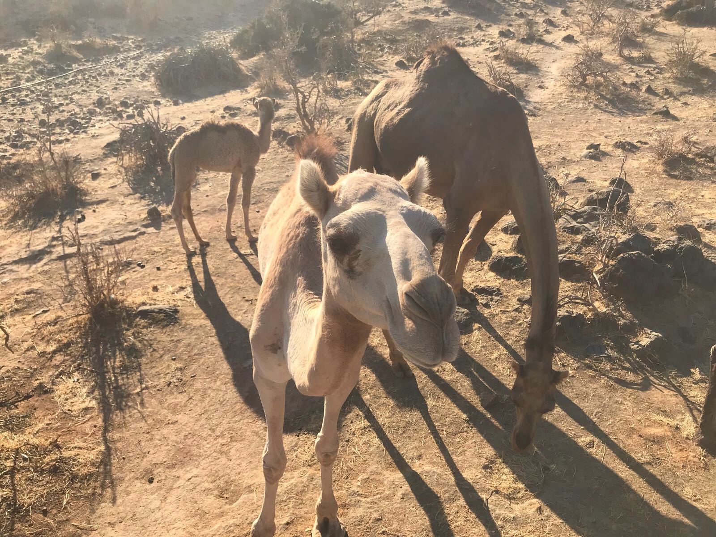
Lexical Density - colours
Basic
āfərūt ‘red’
ḥūrōt ‘black‘
ūbənīt ‘white’
həṣ́rīt
Camel
āfərūt ‘bay’
ḥazmayyət ‘black’
ūbənīt ‘white’
həṣ́rīt
ṣamḥamīḥ
mlaḥt ‘peppered’
žūdayyət ‘bright white’
səḥwīw ‘fawn-coloured’
ḥūḳāḳ ‘dark bay’
ṣəḥmēm ‘dark brown’
Goat
āfərūt ‘bay’
ḥūrōt ‘black’
ūbənīt ‘white’
tərḳāś ‘spotted’
təbrēḳ ‘piebald’
ābdīr ‘splodged’
səḥmīm ‘pointed’
ḥəbśēś ‘grey’

Slide 9
4 Stages of measurement system evolution (Cooperrider and Gentner 2019)
Ad hoc comparisons – comparisons done using whatever is at hand (often an upper body-part)
Conventionalization – comparators are used more conventionally and are available to more contexts
Standardization – comparators become regularized and increasingly abstracted from the original thing used in comparisons
Systematization – completely abstracted and can be extended across multiple fields of measurement (ex. height, depth, length and distance in metres)
Notes:
1 – 3 is comparative; 4 they’re relative to one another; long armed people to the market
Measurement terms are between 2 and 3; but what’s happened is be/c another system outside rather than moving to fully systematized they switch to metric where it’s already systematized
Point is – some is standardized, some is conventionalized but none systematized
(bamboo canes – in another paper – becomes a standard for body parts like arms and stride)

Slide 10
Quantification systems - livestock
ndərēnōt ‘smaller than ndərēt’
ndərēt ‘very few goats, cows or camels – enough animals to produce milk for a very small child; 3-5’
ḥəṣ́ərānōt ‘very small herd of goats, cows or camels’
ḥṣ́ār ‘very small herd of goats, cows or camels’
gəzḥānōt ‘herd smaller than 30 goats/cows’ -small
gəzḥāt ‘herd of about 30 goats/cows’ –medium (or people!)
farḳ ‘herd of goats between 40 and 80’ – large
həfrōḳ ‘plural of farḳ’
məġzēl ‘even larger group of goats’
ġənṭəlōt ‘large herd of cows’
ṭəḥawb ‘large herd of camels’
aug. ṭəḥībūn ‘very large herd of camels‘
Notes:
Stage 2 –conventionalized measurements. Comparators are usually what the livestock is able to support; perhaps the beginning of standardization as some of these can be used for people, too
Instrumental – tells us what they were used for

Slide 11
Quantification systems – Dry measures
məġrēf, pl. mġōrəf ‘half a coconut shell dry measure m.’

Slide 12
Quantification systems – Dry measures
məġrēf, pl. mġōrəf ‘half a coconut shell dry measure m.’
rbayt, pl. rbōya ‘two məġrēf measures m.’

Slide 13
Quantification systems – Dry measures
məġrēf, pl. mġōrəf ‘half a coconut shell dry measure m.’
rbayt, pl. rbōya ‘two məġrēf measures m.’
gmōn, pl. gəmnīn ‘three məġrēf measures m.’

Slide 14
Quantification systems – Dry measures
məġrēf, pl. mġōrəf ‘half a coconut shell dry measure m.’
rbayt, pl. rbōya ‘two məġrēf measures m.’
gmōn, pl. gəmnīn ‘three məġrēf measures m.’
məkyūl, pl. mkaylət ‘four məġrēf measures m.’

Slide 15
Quantification systems – Dry measures
məġrēf, pl. mġōrəf ‘half a coconut shell dry measure m.’
rbayt, pl. rbōya ‘two məġrēf measures m.’
gmōn, pl. gəmnīn ‘three məġrēf measures m.’
məkyūl, pl. mkaylət ‘four məġrēf measures m.’
ntazgət, pl. nzəgūtən ‘ten məkyūl measures f.’ (40 half-coconut shells)

Slide 16
Quantification systems – Dry measures
məġrēf, pl. mġōrəf ‘half a coconut shell dry measure m.’
rbayt, pl. rbōya ‘two məġrēf measures m.’
gmōn, pl. gəmnīn ‘three məġrēf measures m.’
məkyūl, pl. mkaylət ‘four məġrēf measures m.’
ntazgət, pl. nzəgūtən ‘ten məkyūl measures f.’ (40 half-coconut shells)
bhōr, pl. bhūrət ‘ten ntazgət measures m.’
Notes:
Stage 3ish because, though we don’t know specifically, I highly doubt someone sits in the market place and counts out 400 coconut shells of flour for their customers
Not in other areas of the area because only found in Dhofar – naturally
One measuring tool but different words shows how resistant to systematization
Measurement system is newer than linguistic processes – coconuts came in over ocean currents reasonably recently

Slide 17
Quantification systems – Dry measures
məġrēf, pl. mġōrəf ‘half a coconut shell dry measure m.’
rbayt, pl. rbōya ‘two məġrēf measures m.’
gmōn, pl. gəmnīn ‘three məġrēf measures m.’
məkyūl, pl. mkaylət ‘four məġrēf measures m.’
ntazgət, pl. nzəgūtən ‘ten məkyūl measures f.’ (40 half-coconut shells)
bhōr, pl. bhūrət ‘ten ntazgət measures m.’
Numerals
1 - ṭād, ṭayt 6 – (y)əttīt, hitt
2 - t̠roh, t̠rayt 7 – ībayt, hōba
3 - śāt̠ayt, śhəlīt 8 – t̠əmnīt, t̠əmōni
4 - arbōt, arba 9 – sʔayt, sɛ̄ʔ
5 - xəmmoh, xayməh 10 – āśərīt, ʔōśər
(Watson, al-Mahri et al. 2020, 81)
Notes:
There are words for numbers in Mehri but they are not related to the dry measurement words at all. Nor are the related to the herd size names we saw earlier

Slide 18
Event Description

Slide 19
ḏīməh təghō:m fənwūk / gəreh fənwū:k For that you go straight on, go straight on

Slide 20
ghōm / ghōm / mġōrən ūfēf śayməl wə-ghōm ghōm ghōm əttā təksē məġṣayṣ Continue going, and then turn left and keep going until you find an alley.

Slide 21
ḏayk ḏ-agarəs / dfiṣ̌əs / wə-slō:::b / wət / əttā yūḳəf wət ūḳəf ḳfēd / that for the bell. Press it. And wait. When it stops, when it stops get out.

Slide 22
tənūgəś tənūgəś tənūgəś tənūgəś tā: thanḳəl you churn and churn and churn until you make it turn

Slide 23
wə-mōṣəl bar xōṭər yəkūn barh hīs yəkūn hṣ́aw:r hṣ́aw:r hṣ́awr and whey is underneath. When it is ready it is green green green

Slide 24
COMPARATOR
Length of utterance in time
Reduplication
Elongation
TARGET
Continuous repeated action
Intensity of described property
Duration of event
Beating gesture depicts repeated action
Not necessarily linked to time
If described event includes path, this is usually gestured

Slide 25
Changes
Sedentarisation – living in towns necessarily separates us from nature
Globalisation – leads to global measurement systems – kilo for weight, metres for distance
“If you take people out of their land, you take them out of their meaning, out of their language’s roots. When wild lands are lost, so is metaphor, allusion and the poetry that arises in the interplay of mind and nature, to lose your land is to lose your language, and to lose your language is to lose your mind, as John Clare, England’s peasant poet (born in 1793), knew.” (Griffiths 2007, p.30)
Notes:
Why these changes are happening - globalization

Slide 26
With thanks to
Leverhulme Trust for project grant (2013-2016) during which time materials collected
Abdullah al-Mahri
Ahmed Musallam al-Mahri
Musallam Hazmay al-Mahri
Marie-Claude Simeone-Senelle
Commonwealth Scholarship Commission

Slide 27
Selected references
CELCE (2019). Centre for Endangered Languages, Cultures and Ecosystems. School of Languages, Cultures and Societies at the University of Leeds. https://ahc.leeds.ac.uk/centres-groups/doc/centre-endangered-languages-cultures-ecosystems-1
Cooperrider, K. and D. Gentner (2019). "The career of measurement." Cognition 191: 103942.
Gorenflo, L. J., et al. (2012). "Co-occurrence of linguistic and biological diversity in biodiversity hotspots and high biodiversity wilderness areas." Proceedings of the National Academy of Sciences of the United States of America 109(21): 8032-8037.
Griffiths, J. (2007). Wild: An Elemental Journey, Penguin Books Limited.
Harrison, D. K. (2007). When languages die: the extinction of the world's languages and the erosion of human knowledge. New York, Oxford University Press, USA.
Thomason, S. G. (2015). Endangered languages: an introduction. Cambridge, Cambridge University Press.
Watson, J. C. E., et al. (2020). Təghamk Āfyət: A course in Mehri of Dhofar, Harrassowitz.

